Slide 1

DOES CRIME TAKE A HOLIDAY
Patrick Drury
Brandes Moore
Ha Nguyen
~Nashville Software School ~ Data Analytics Jumpstart
October 24, 2019

Slide 2
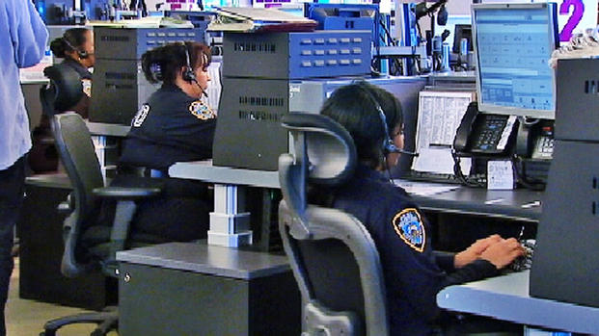
Questions: Do crimes happen on holidays? What holidays have the highest crime calls? What crime(s) are called in on these specific holidays?

Slide 3

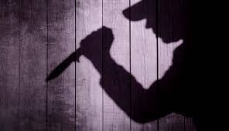



Do crimes happen on holidays?
YYYYEEEESSSSSSSS !!!!!!

Slide 4
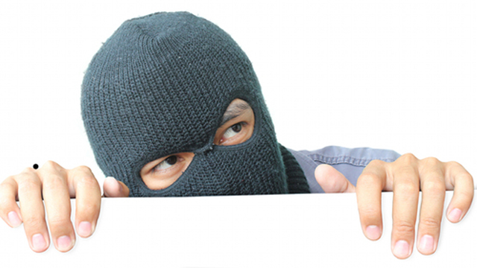
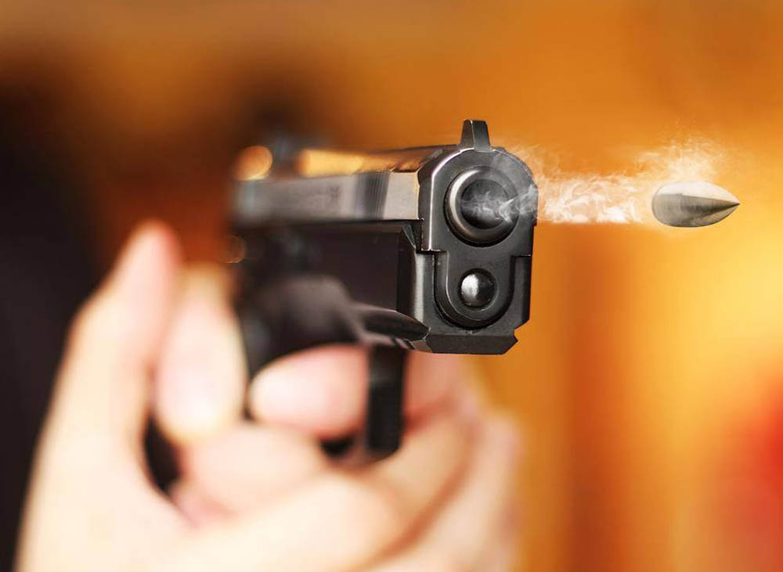
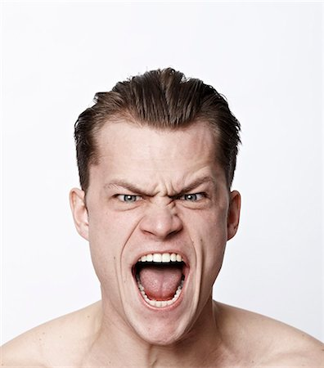

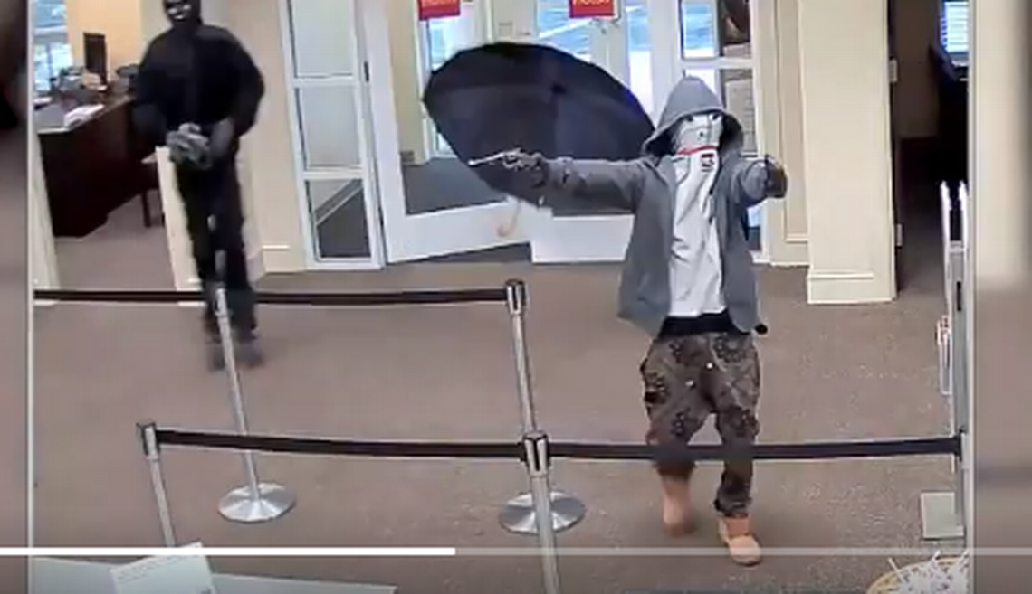
CRIME CALLS & HOLIDAYS EXAMINED (Based on 2013 Police Calls**)
CRIMES
Burglaries
Robberies
Thefts
Shootings (Pew Pew)
Person Screaming (Ahhh)
HOLIDAYS
New Year’s Day
Memorial Day
Independence Day
Halloween
Thanksgiving
Christmas

Slide 5
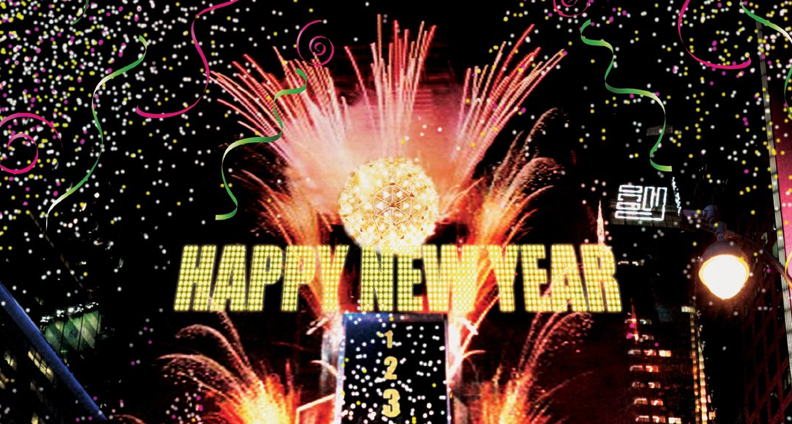
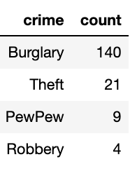
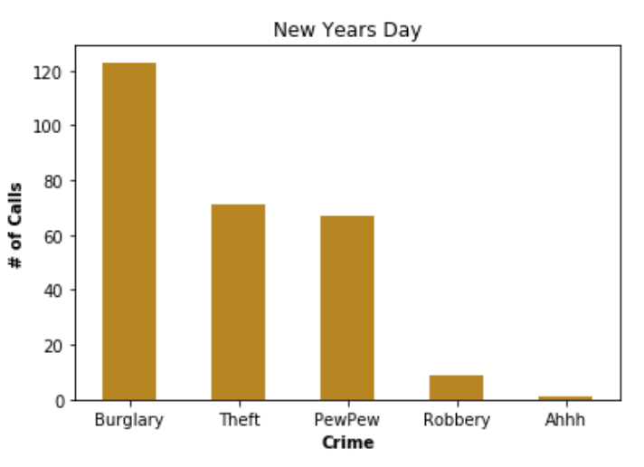
New Year’s Day

Slide 6
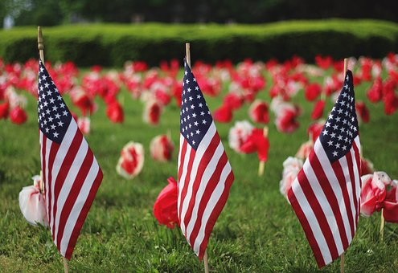
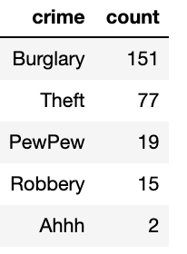
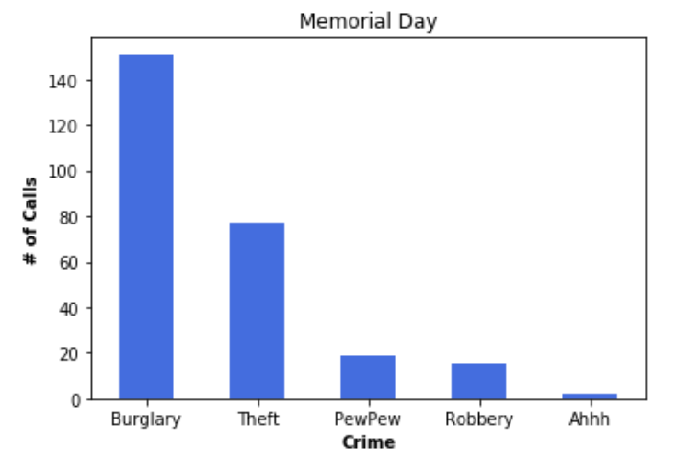
Memorial Day

Slide 7

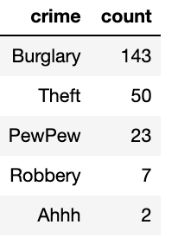
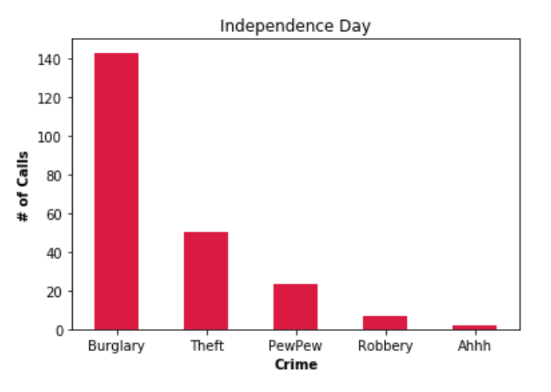
Independence Day

Slide 8
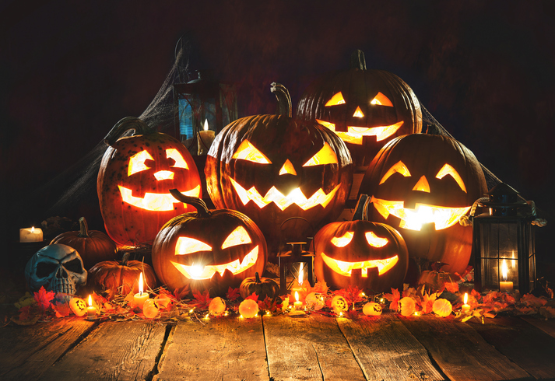
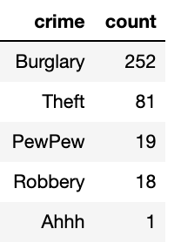
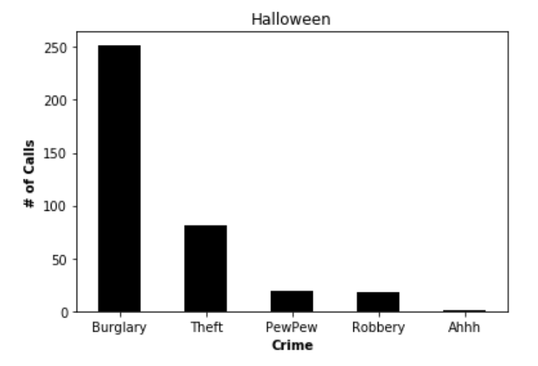
Halloween

Slide 9
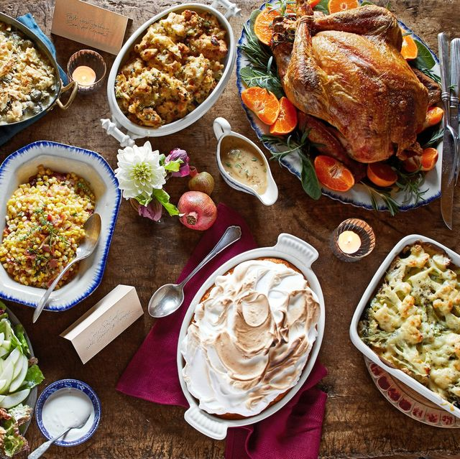
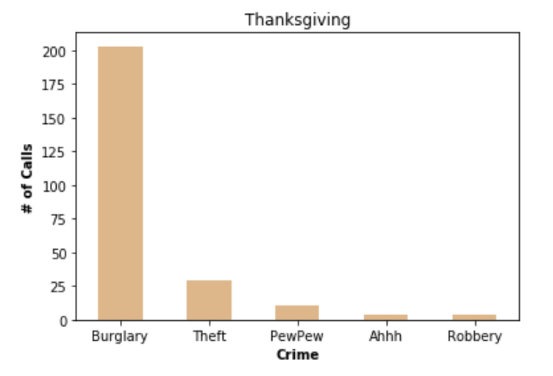
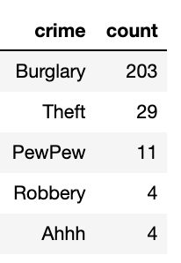
Thanksgiving

Slide 10
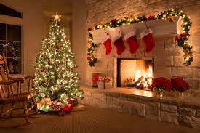
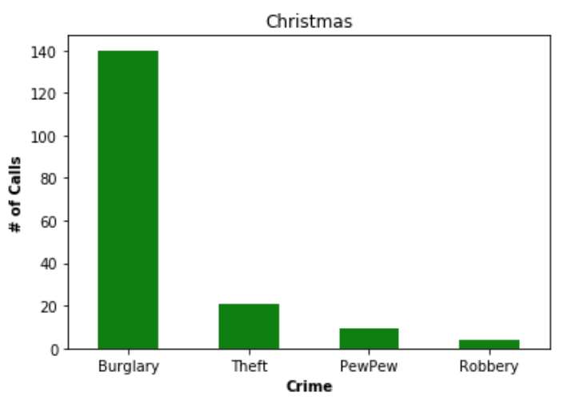
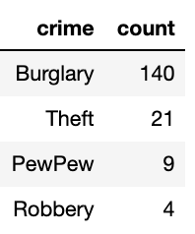
Christmas

Slide 11
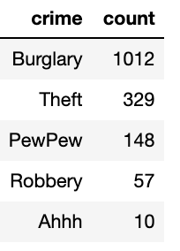
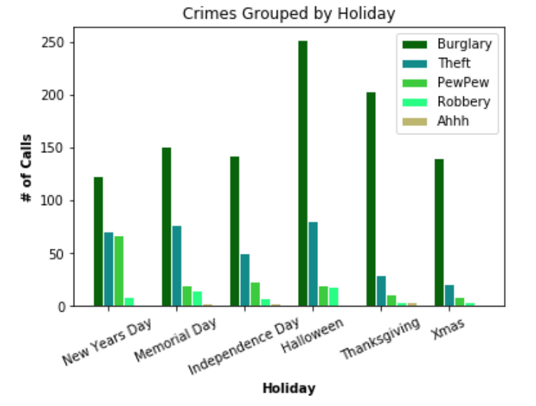
Crime Comparison for 2013

Slide 12
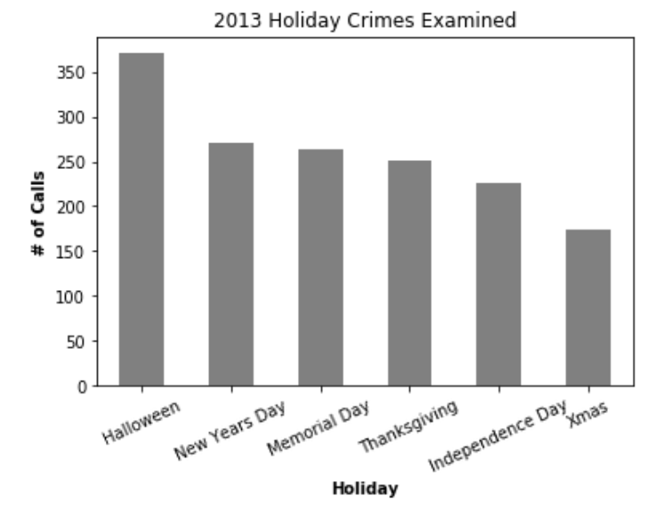
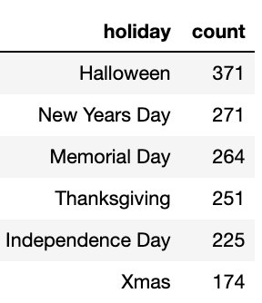
What holidays have the highest crime calls?

Slide 13
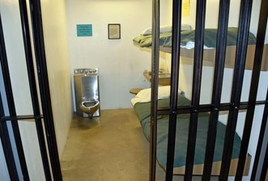
CONCLUSION
What holidays have the highest crime calls?
~ Halloween, followed by New Year’s Day
What crime(s) are called in on these specific holidays? ~Burglaries and Theft

Slide 14

QUESTIONS

